Slide 1
Space Groups
What are they and why do we need them?
Andreas Decken, University of New Brunswick

Slide 2
Thanks
To so many people that provided slides
and suggestions

Slide 3
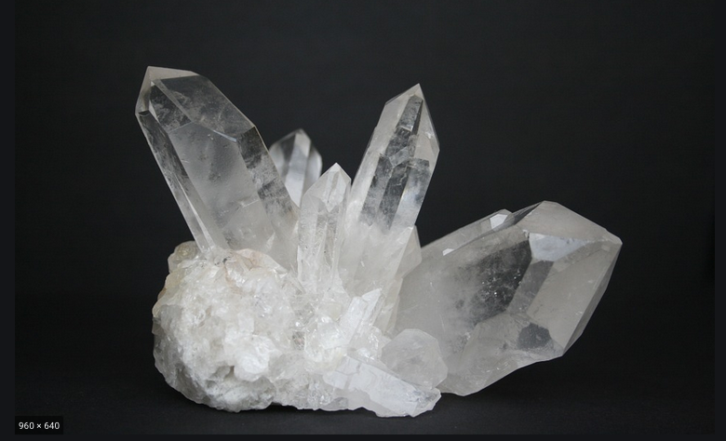

Slide 4


Slide 5


Slide 6


Slide 7
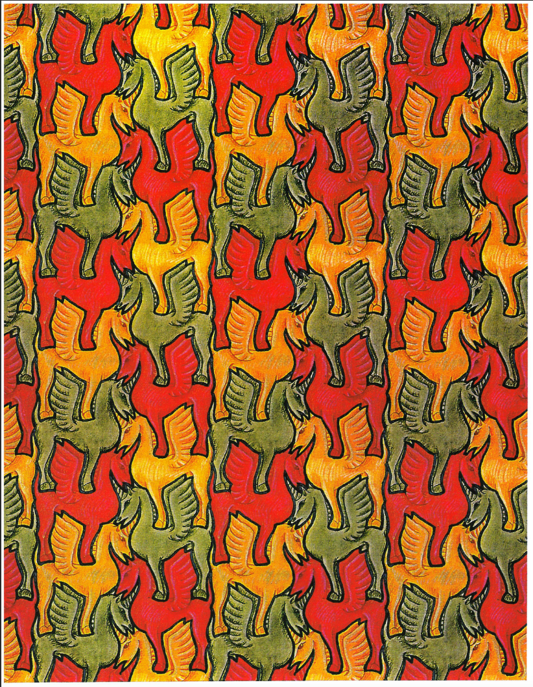
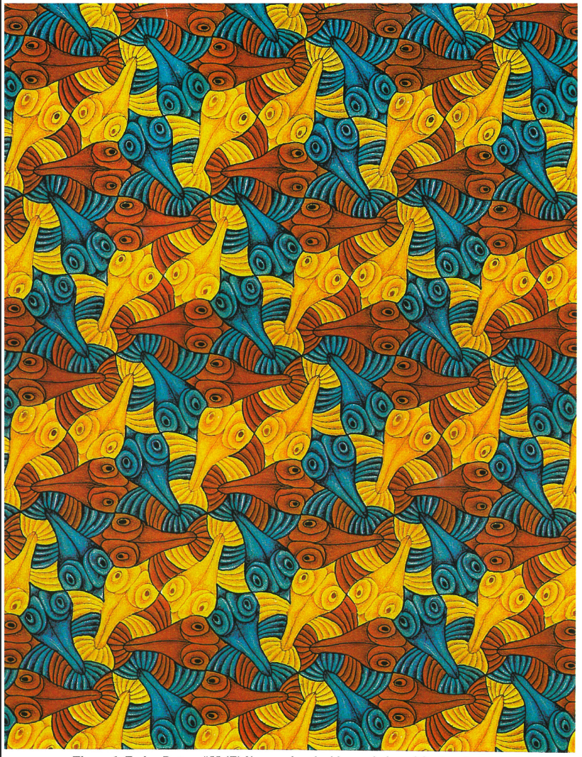

Slide 8
Your Data is Precious
How many data points do we need to solve the following equation?
y = ax + b
y = ax² + bx +c
In an X-ray diffraction experiment we obtain a limited amount of data
If we want precise bond length/angles we want to optimize how we use data

Slide 9
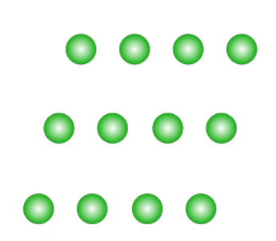

Slide 10
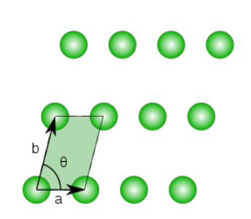


In the absence of symmetry, we can choose every possible unit cell.

Slide 11
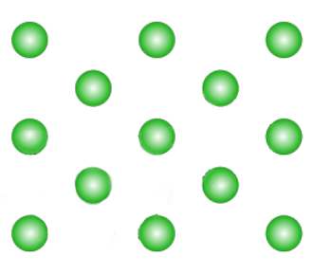

Slide 12
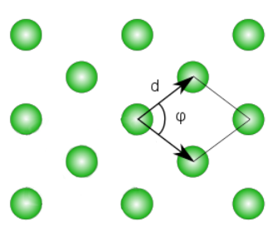

Slide 13
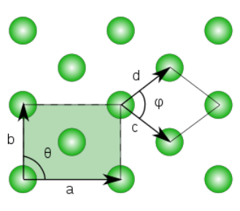
Hein Schaper:
To correctly describe our structure, we have always to choose the highest possible symmetry.

Slide 14
How can we describe a crystal which contains a certain symmetry, for example a mirror plane, but the smallest cells are incompatible with these symmetry elements.
We choose a cell of higher volume, containing more than one lattice point, a so called centered cell. In this example, we have a C-centered cell.

Slide 15
Bravais Lattices
Courtesy: Charles Campana
Within each crystal system, different types of centering produce a total of 14 different lattices.
P – Simple
I – Body-centered
F – Face-centered
B – Base-centered (A, B, or C-centered)
All crystalline materials can have their crystal structure described by one of these Bravais lattices.
Notes:
Within each crystal system different types of centering (consistent with symmetry) exist which add up to a total of 14

Slide 16
Courtesy: Charles Campana

Slide 17
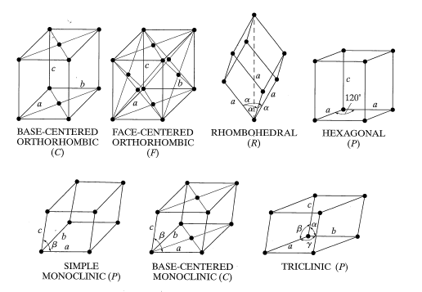
Bravais Lattices
Courtesy: Charles Campana
Cullity, B.D. and Stock, S.R., 2001, Elements of X-Ray Diffraction, 3rd Ed., Addison-Wesley
Notes:
Within each crystal system, a total of 14 different types of centering (consistent with symmetry) exist.

Slide 18
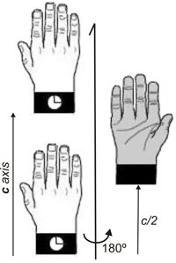
Two-fold Screw Axis
Credit: M. Kastner, T. Medlock & K. Brown, Univ. of Bucknell
Source: https://www.xtal.iqfr.csic.es/Cristalografia/parte_03-en.html

Slide 19
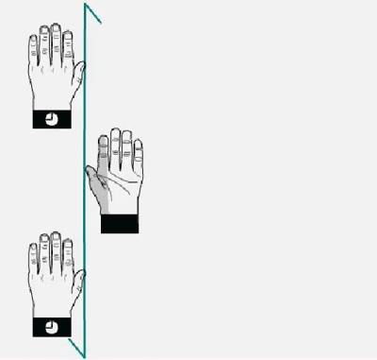
Two-fold Screw Axis
Credit: M. Kastner, T. Medlock & K. Brown, Univ. of Bucknell
Source: https://www.xtal.iqfr.csic.es/Cristalografia/parte_03-en.html

Slide 20
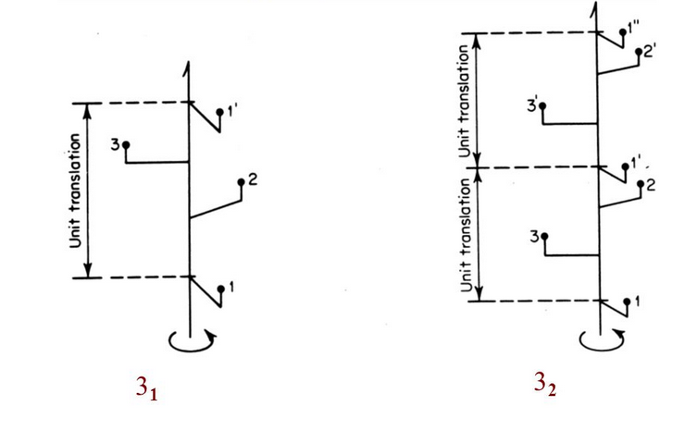
Three-fold Screw Axis
Source: G.H Stout & L.H. Jensen - X-Ray Structure Determination (A Practical Guide)

Slide 21
Screw Axes
Combination of translation and rotation
Designated as n_{m} (e.g. 2₁, 3₁, 3₂)
Rotation as 360º/n
Translation as m/n of a unit cell
Symmetry element of the first kind
Courtesy: Paul Boyle

Slide 22
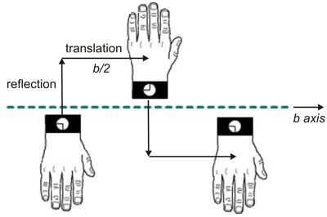
Glide Plane
Credit: M. Kastner, T. Medlock & K. Brown, Univ. of Bucknell
Source: https://www.xtal.iqfr.csic.es/Cristalografia/parte_03-en.html

Slide 23

Glide Plane
Credit: M. Kastner, T. Medlock & K. Brown, Univ. of Bucknell
Source: https://www.xtal.iqfr.csic.es/Cristalografia/parte_03-en.html

Slide 24
Glide Planes
Combination of translation and reflection
Designated as a, b, c, n, d
Translation as a/2 (a-glide), b/2 (b-glide)or c/2 (c-glide)
Symmetry element of the second kind
Courtesy: Paul Boyle

Slide 25
n and d Glide Planes
n glides translate along face diagonals, (a+b)/2, (a+c)/2, or (b+c)/2
d glides only occur F and I centred lattices
d glides translate along face diagonals at ¼ along each direction, i.e. (a+b)/4, (a+c)/4, or (b+c)/4
Courtesy: Paul Boyle

Slide 26

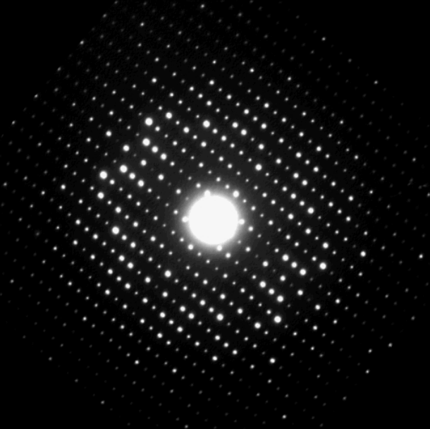
Describe infinite lattices
14 Bravais
Lattices
Centering
Point groups
7 Crystal
Systems
230 Space
Groups
Describe the ways in which
identical objects can be
arranged in an infinite lattice
Proper rotation axes
Mirror planes
Inversion Center
Rotary Inversion Axes
Unit cell translations
Centering
Screw Axes
Glide planes
32 Point
Groups
Rotation
Reflection
Describe the symmetry
of isolated objects
Centrosymmetric subgroup
11 Laue Groups

Slide 27
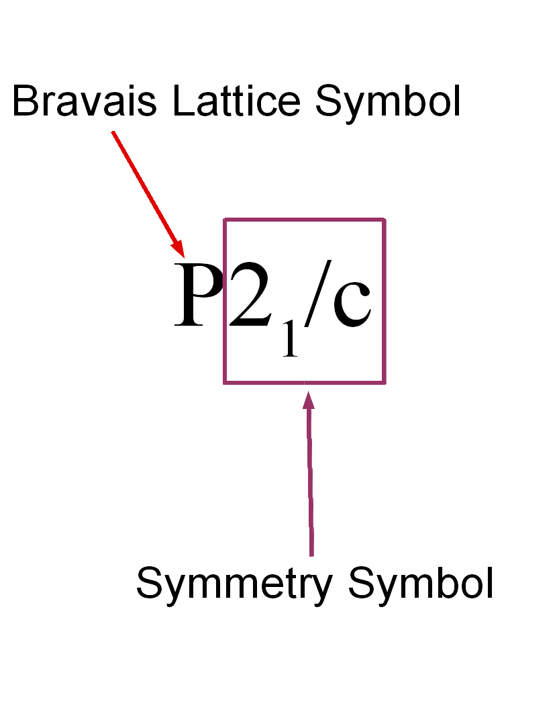
Interpretation of Space Group Symbols
Space group symbols consist of several parts
Bravais lattice type
List of symbols denoting type and orientation of symmetry elements
Must know the Crystal System in order to correctly interpret the space group symbol
Courtesy: Paul Boyle

Slide 28
Representations of Symmetry
Graphical Representation
Qualitative and Symbolic
Non-mathematical
Visually intuitive (for the most part)
Equivalent positions (x,y,z)
Simple algebraic expressions
Good for humans
Matrix Representation
Easy to transform
Numerically oriented
Good for computers
ORTEP Representation
Compact notation of symmetry operation and unit cell translations
Related representations found in PLATON, XP, and CIF

Slide 29
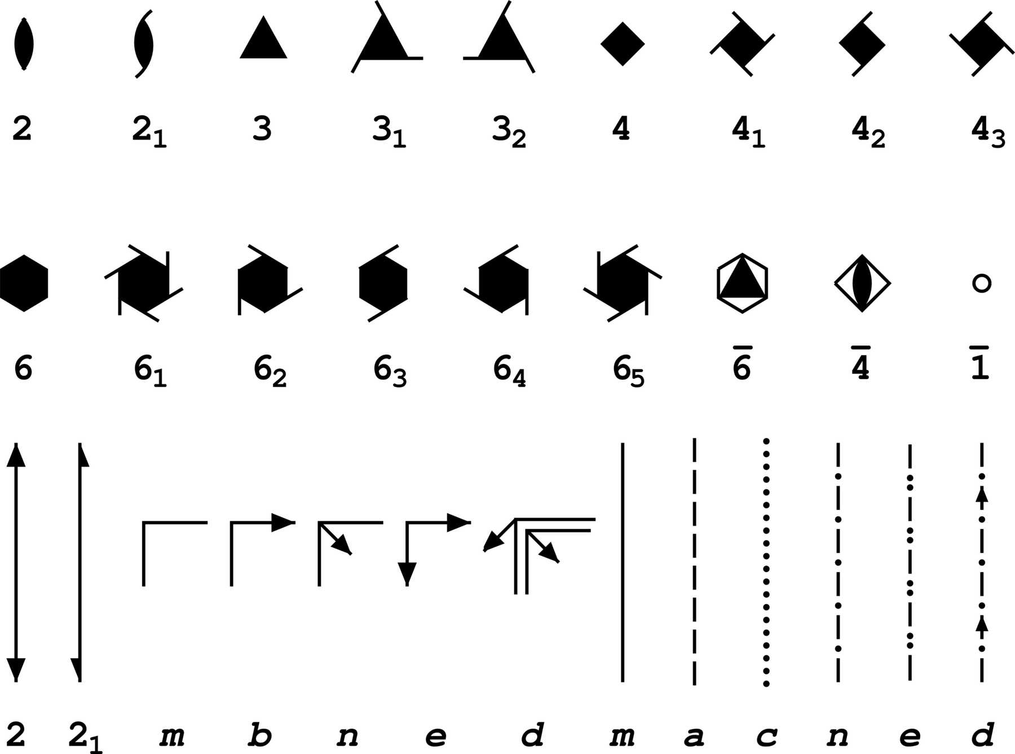
Graphical Representation of Symmetry Elements
Proper rotations depicted as symbols with the number of vertices which corresponds to n
Screw axes have same symbol, but have “tails”
Courtesy: Paul Boyle

Slide 30
Space Groups and Crystallographic Symmetry
A tutorial
Version 1.55m
Fachschule Raumgruppe
Brandeis University

Slide 31
2
by
Jerry P. Jasinski (Keene state college)
and
Bruce M. Foxman (Brandeis University)
(Mac-compatible version by Ian S. Batson, 2015)
Copyright 2004-2015
Support by the National science Foundation through grants DMR-0504000 (Brandeis university) and DMR-0303450 (Clemson University) is gratefully acknowledged

Slide 32
a
c
+
+
+
+
Z=1;

Slide 33
a
,
,
c
-
-
Symbol: = 1-bar = inversion center
+
+
,
,
-
-
+
+
Z=2;

Slide 34


a
½
+
c
+
½
+
+
+
+
½
½
+
+
Z=2;

Slide 35
a
c
c-glide in-plane symbol
+
+
,
-
,
-
+
+
Z=2;

Slide 36
a
c
,
,
¼
-
-
+
+
½ +
½ +
,
,
½ -
½ -
,
,
-
-
+
+
Z=4;

Slide 37
The Asymmetric Unit

Slide 38
The Asymmetric Unit
The asymmetric unit is the smallest portion of a crystal structure to which symmetry operations can be applied in order to generate the complete unit cell

Slide 39
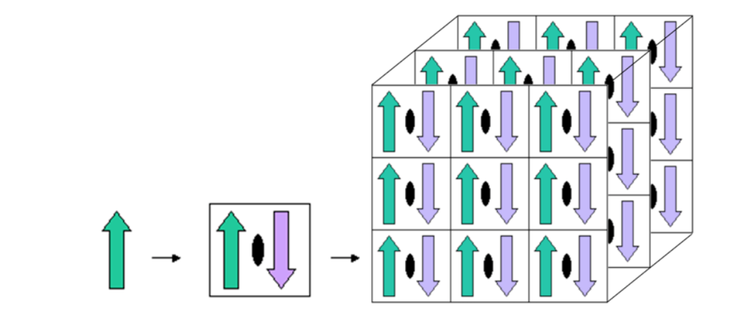

Asymmetric Unit Cell Entire Crystal
Unit

Slide 40
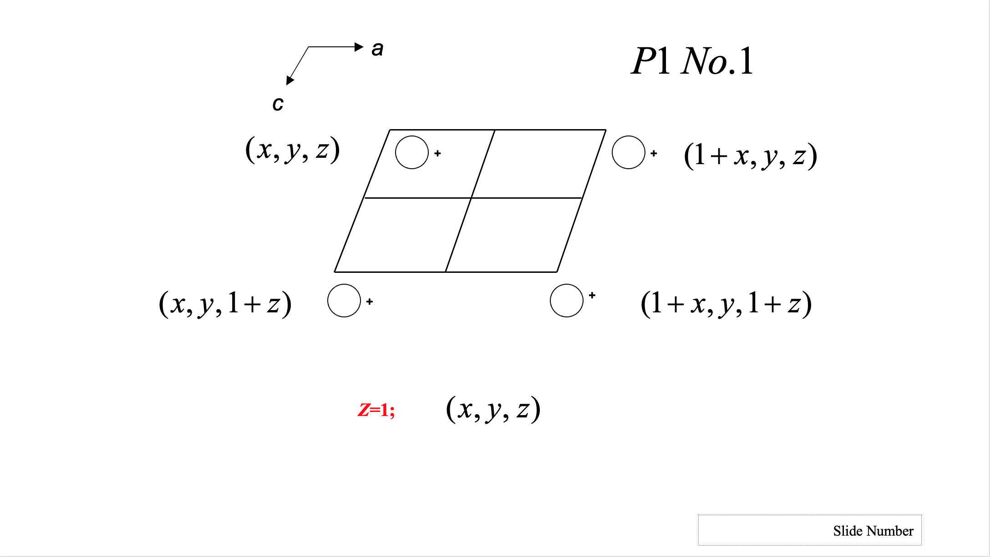


Slide 41
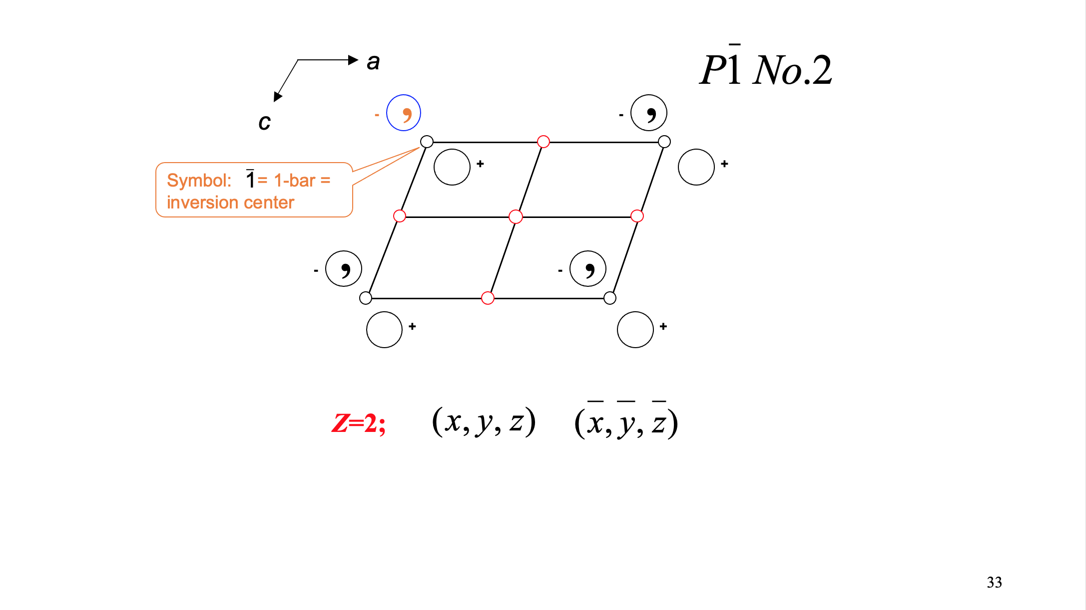

Slide 43
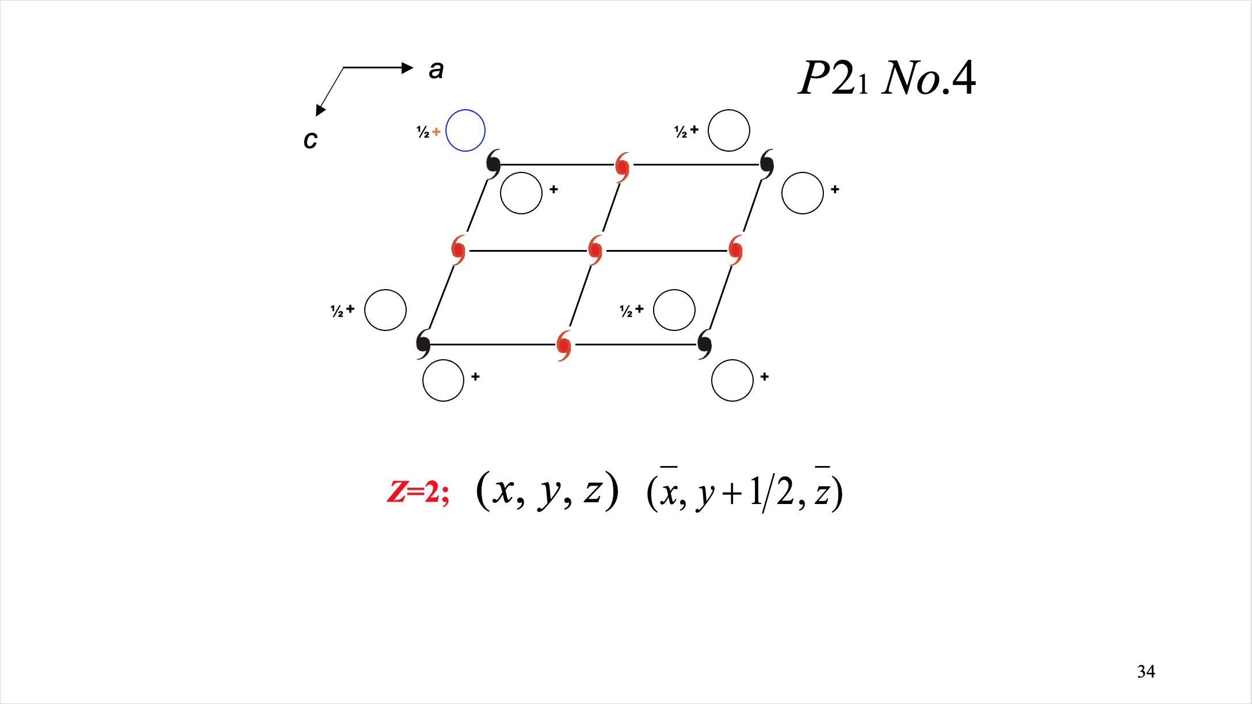

Slide 44
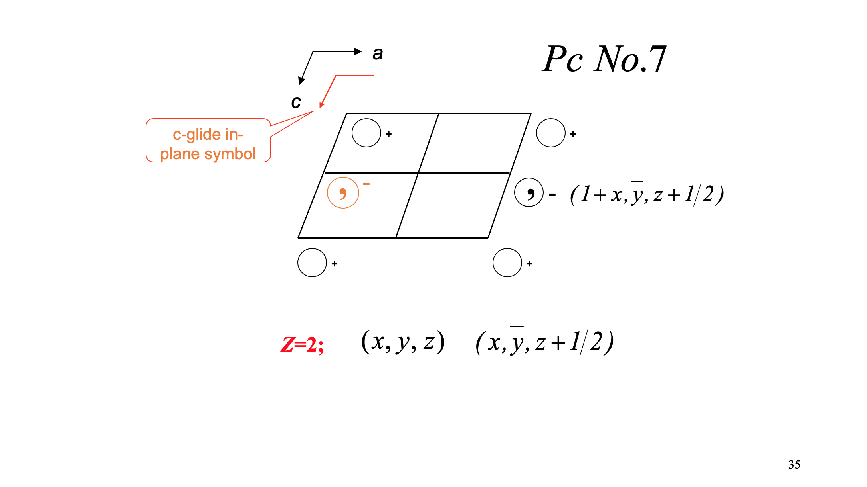

Slide 45
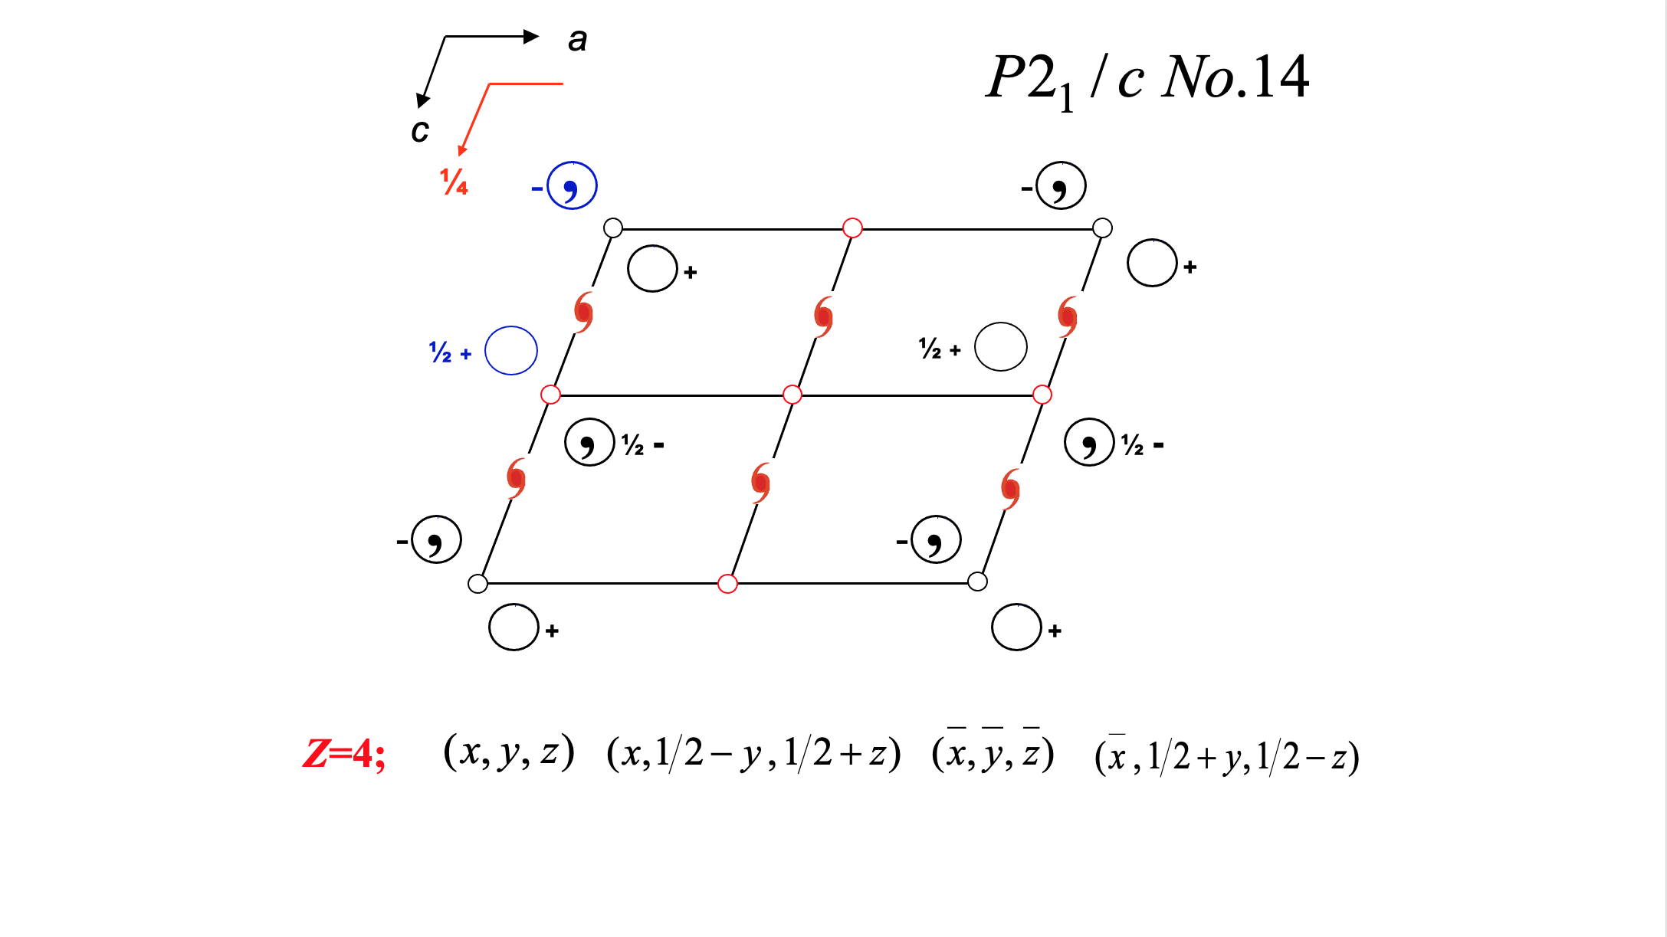

Slide 46
Equivalent Position Representation
Simple algebraic expressions
Good for humans
P2₁/c example
x, y, z
x, y + ½, z + ½
x, y, z
x, y + ½, z + ½
_
_
_
_
_
_
Courtesy: Paul Boyle

Slide 47
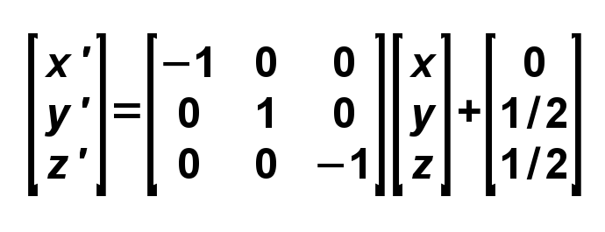
Matrix Representation of Symmetry
Symmetry operator can be partitioned into a rotational part and a translational part
Rotations can be described as simple 3x3 matrices. Matrix elements are either 1, 0, or -1
Translations described as 3x1 matrix
v' = Rv + t where v = [x,y,z]
For example, in P2₁/c the equivalent position: x, y + ½, z + ½ looks like this in matrix representation:
_
_

Slide 48
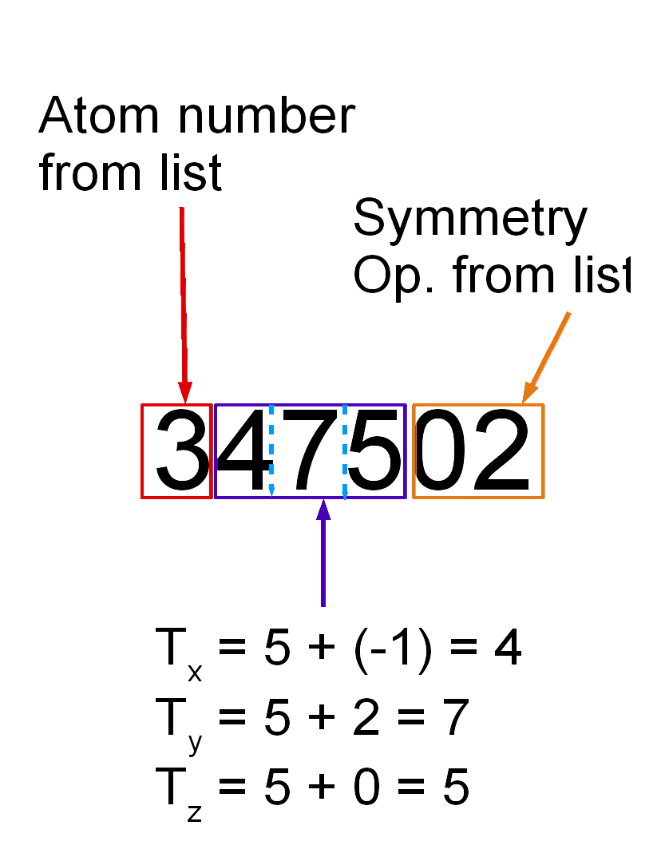
ORTEP Symmetry Representation
Early days of computing memory was expensive
Needed compact way to depict symmetry equivalent atomic positions including translations
Avoid negative numbers in unit cell translations
“5” is the new “0”
Example: 347502
Depends on lists of atoms and symmetry operators elsewhere in the file or the program
Courtesy: Paul Boyle

Slide 49
PLATON, XP, and CIF Symmetry Codes
Derived and modified from original ORTEP scheme, maintains compactness
PLATON: [sym_op][T_{x}T_{y}T_{z}].[residue]
e.g. 2565.01
XP: [sym_op][T_{x}T_{y}T_{z}]
e.g. 2565
CIF: [sym_op]_[T_{x}T_{y}T_{z}]
e.g. 2_565
All depend on a list of symmetry operators being defined somewhere else in the file or the software
Courtesy: Paul Boyle

Slide 50
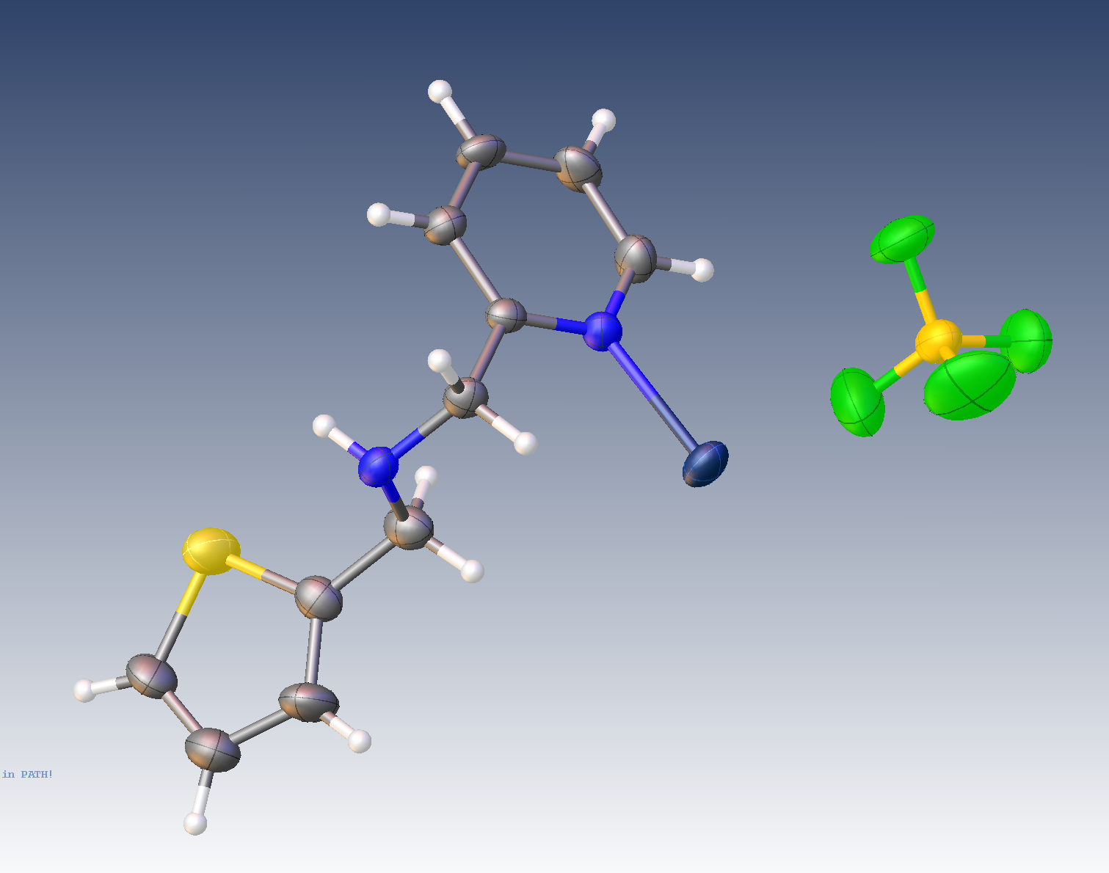
Structure courtesy of Russel Bell

Slide 51
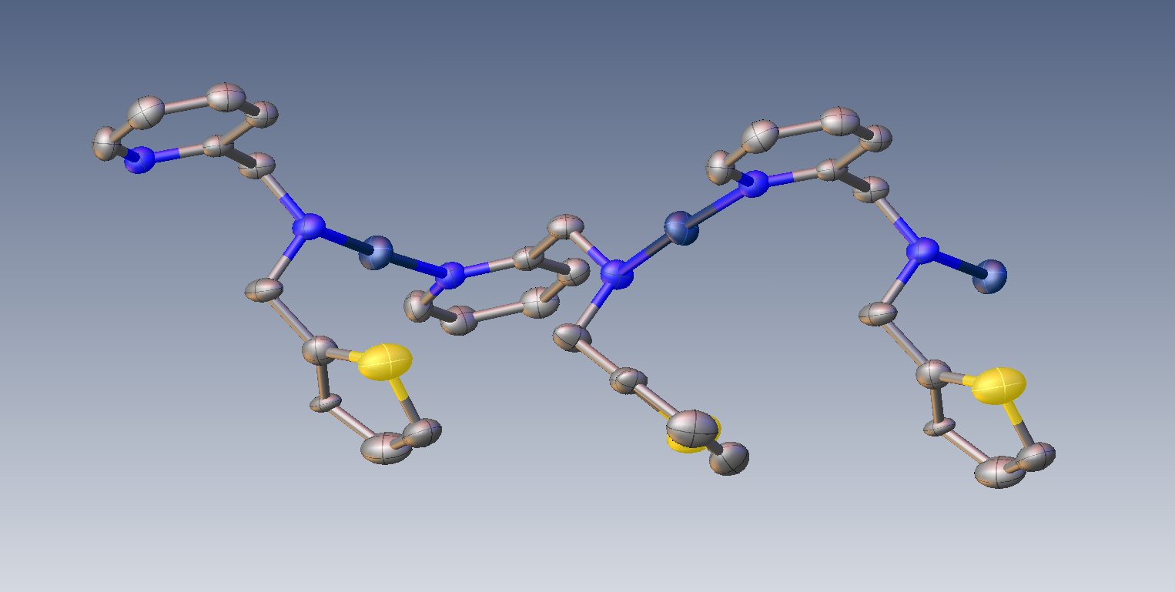
Structure courtesy of Russel Bell

Slide 52
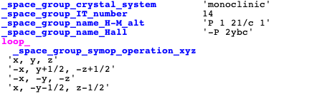
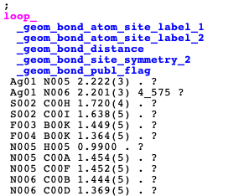
Small Molecule Example – a14 Generation of CIF Files
All of the crystallographic journals and most of the major chemical journals have now adopted the CIF (Crystal Information Format) for depositing and publishing crystallographic data.
Most commercial and public-domain structure refinement programs now generate CIF files for validation and deposition.
Adapted from: Charles Campana

Slide 53
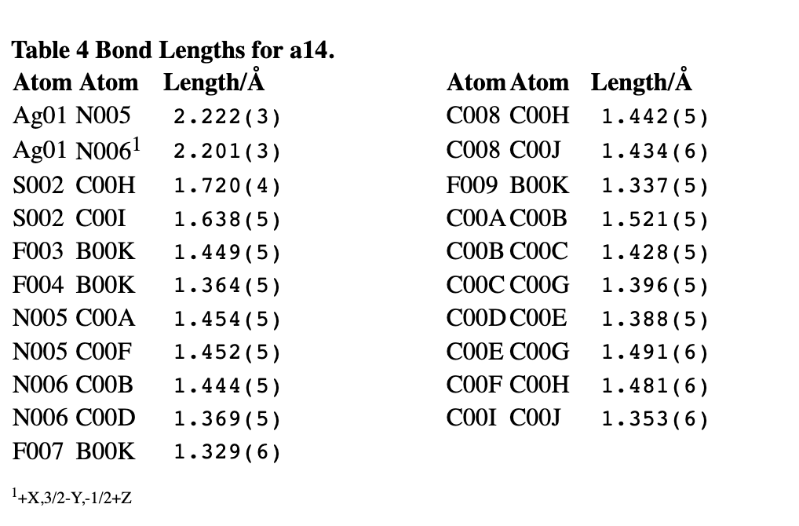
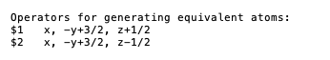
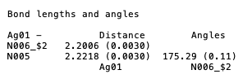
SHELX output
Olex Tables for Publication

Slide 54
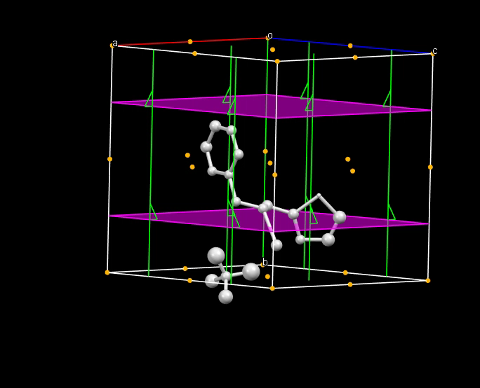
Mercury view Courtesy: Jim Britten

Slide 55
International Tables for Crystallography
Information on crystallographic symmetry and related topics has been codified and published in the International Tables for Crystallography
Originally published in 1935, the work has been revised and expanded to include all sorts of topics relevant to X-ray Crystallography
We will only concern ourselves with material related to space groups (Volume A)
Courtesy of Paul Boyle

Slide 56
Using the International Tables for X-ray Crystallography
The International Tables (IT) contain information on all space groups
Most common information used by crystallographers:
Graphical depictions
Equivalent positions
Special positions and site symmetries
Systematic absence conditions
Courtesy of Paul Boyle

Slide 57
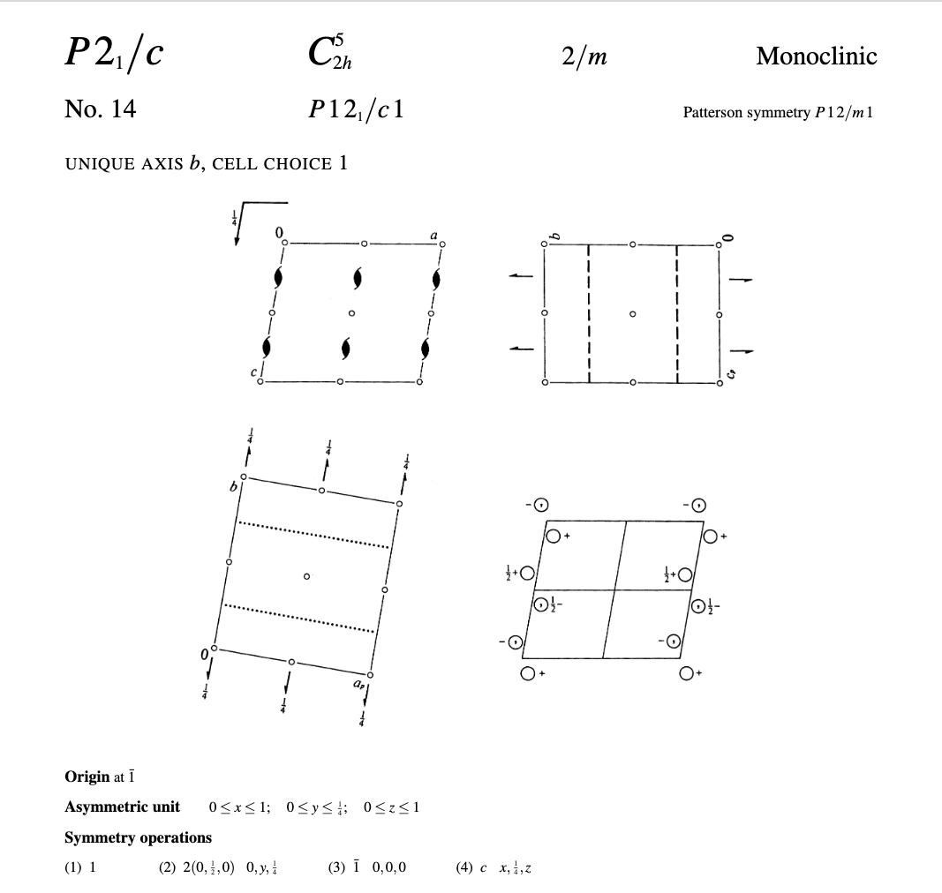
Example of International Tables Example (P2₁/c)

Slide 58
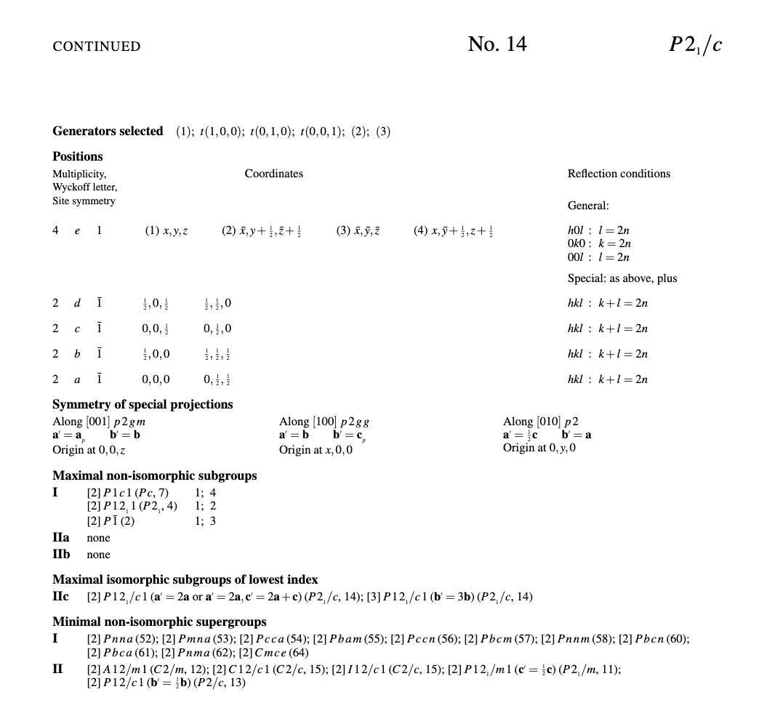
Example of International Tables Example (P2₁/c)

Slide 59
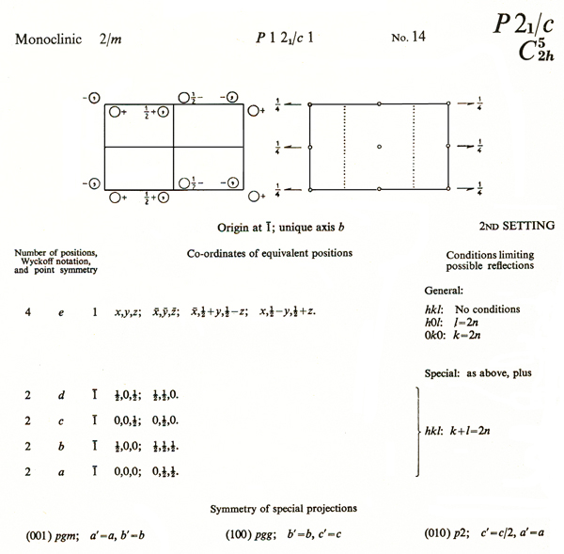
Example of International Tables Example (P2₁/c)

